Slide 1
Introduction to Convolutional Neural Networks
Project: Cats vs dogs prediction

Slide 2


List Of Contents
What are drawbacks of ANN
7. Dicussion,Conclusion and Refrences

Slide 3
Drawbacks of ANN
Fully connected structure where each neuron connects to every other neuron in the next layer.
This structure results in a large number of parameters, making them computationally expensive
prone to overfitting, especially for high-dimensional inputs like images
4
7. Dicussion,Conclusion and Refrences

Slide 4
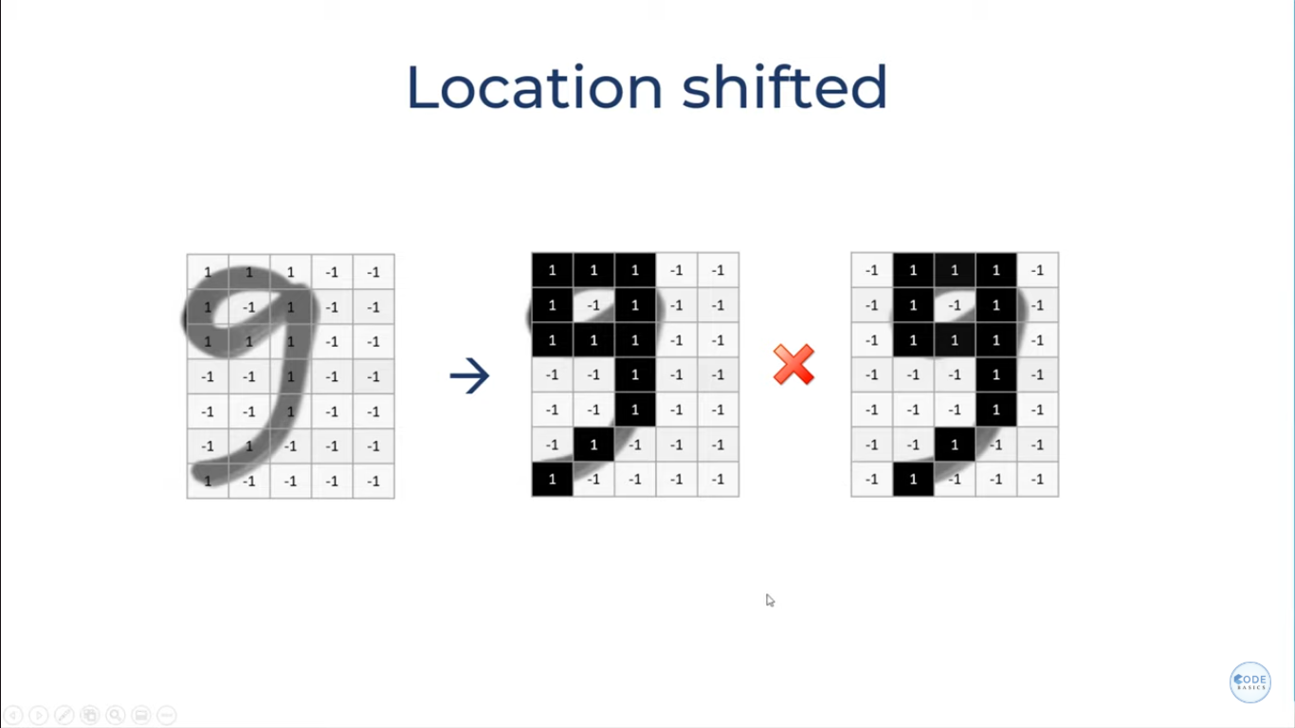

Slide 5
Drawbacks of ANN
ANNs process the entire input as a flat vector, losing the inherent structure of data (e.g., the 2D structure of an image).
This limits their ability to identify and focus on local patterns effectively.
the number of trainable parameters increases exponentially, making it impractical for processing large images or videos.
large number of parameters in ANNs increases the risk of overfitting when training on smaller datasets.
4
7. Dicussion,Conclusion and Refrences

Slide 6
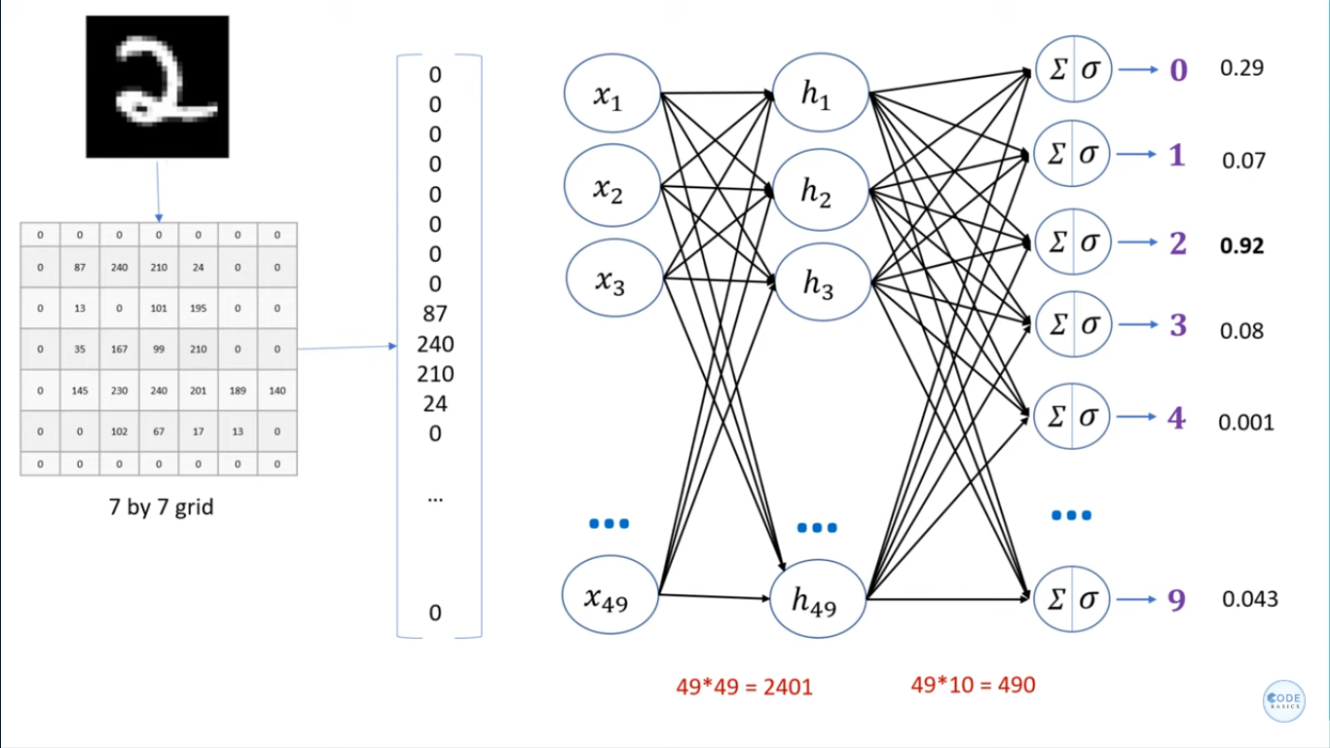
7. Dicussion,Conclusion and Refrences

Slide 7
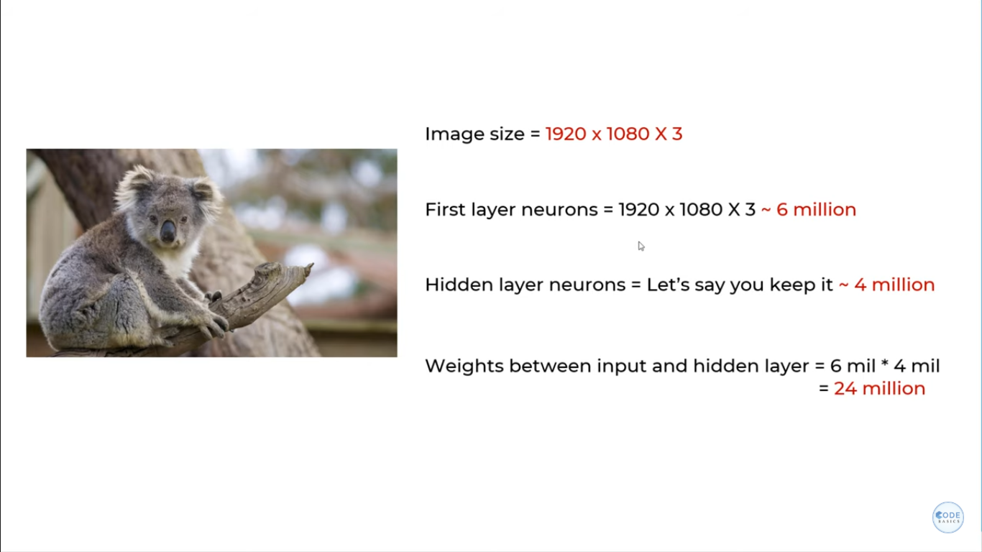
4
7. Dicussion,Conclusion and Refrences

Slide 8
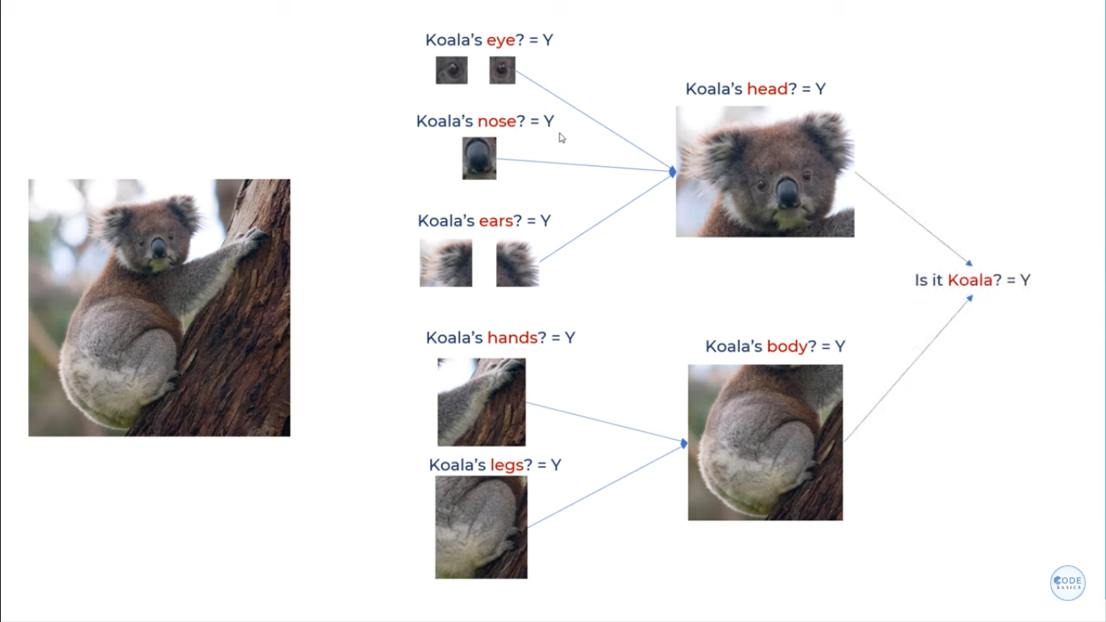
How do Humans recognize such images easily?
4
7. Dicussion,Conclusion and Refrences

Slide 9
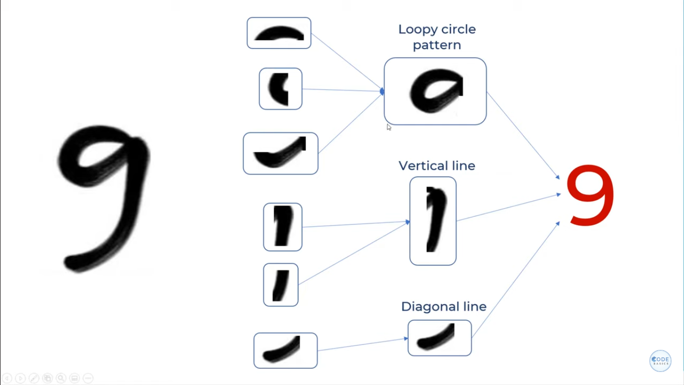

Slide 10
How convolutional Networks work?
They divide image into sections
Identify different patterns individually
CNN use the concept of filters to detect the presence of certain features as per our requirement.

Slide 11
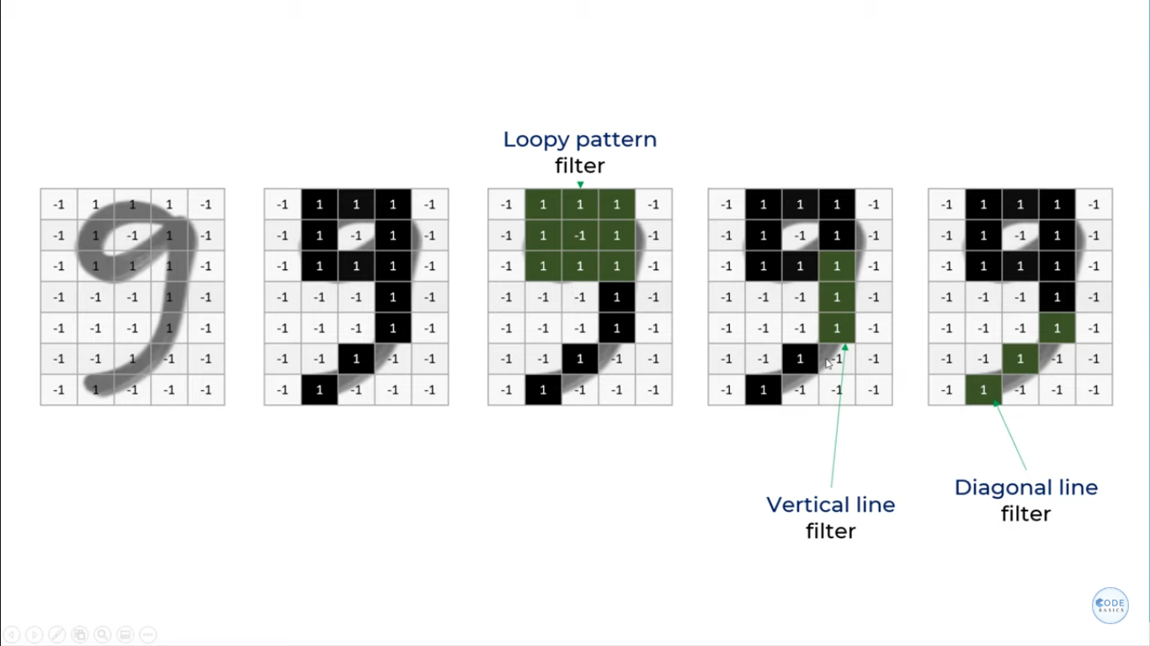

Slide 12
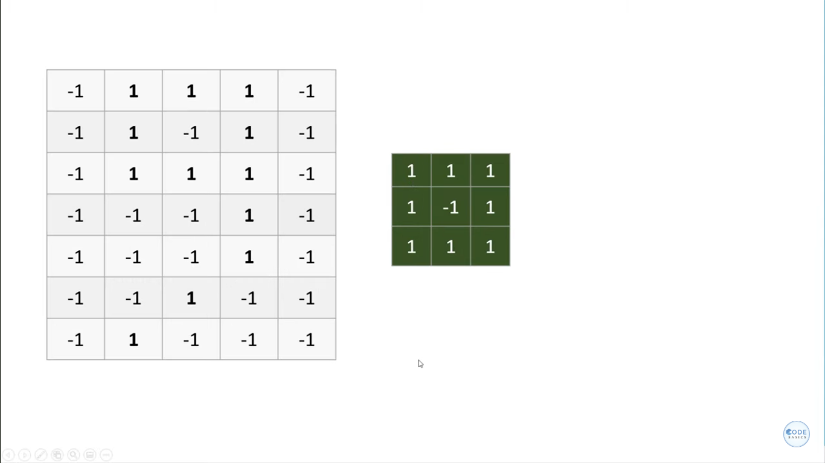
How convolutional Networks work?
Here we want to check is a loop is present in this image or not?
Take the filter of loop and rotate it over our image to find the location of loop

Slide 13
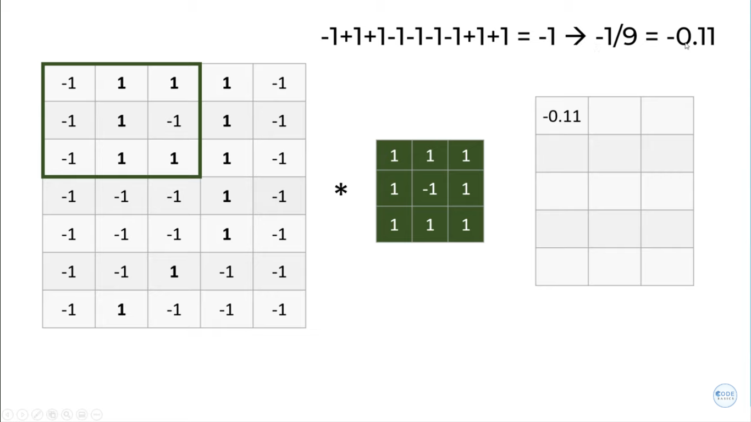
Reading data from original image and transferring it to the feature map using convolutional operation.

Slide 14
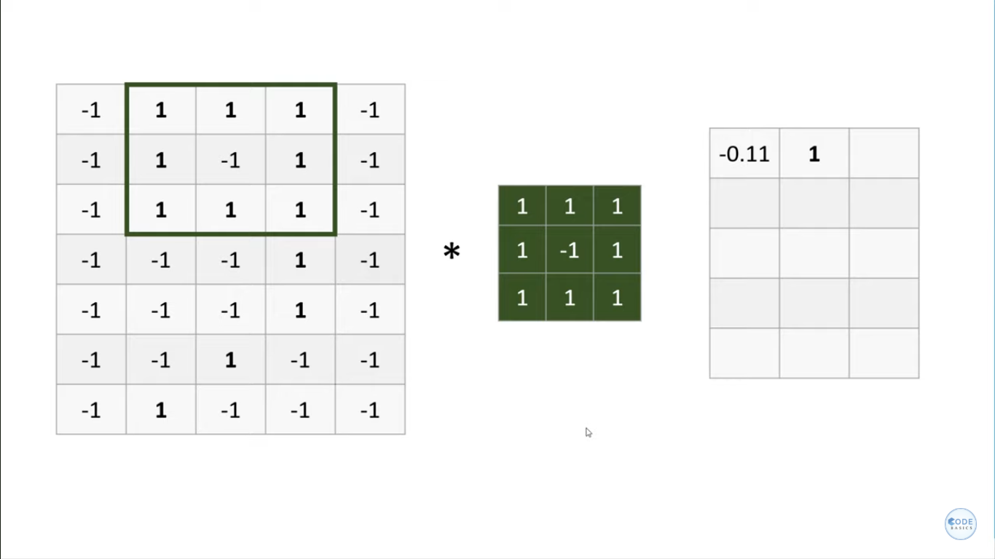
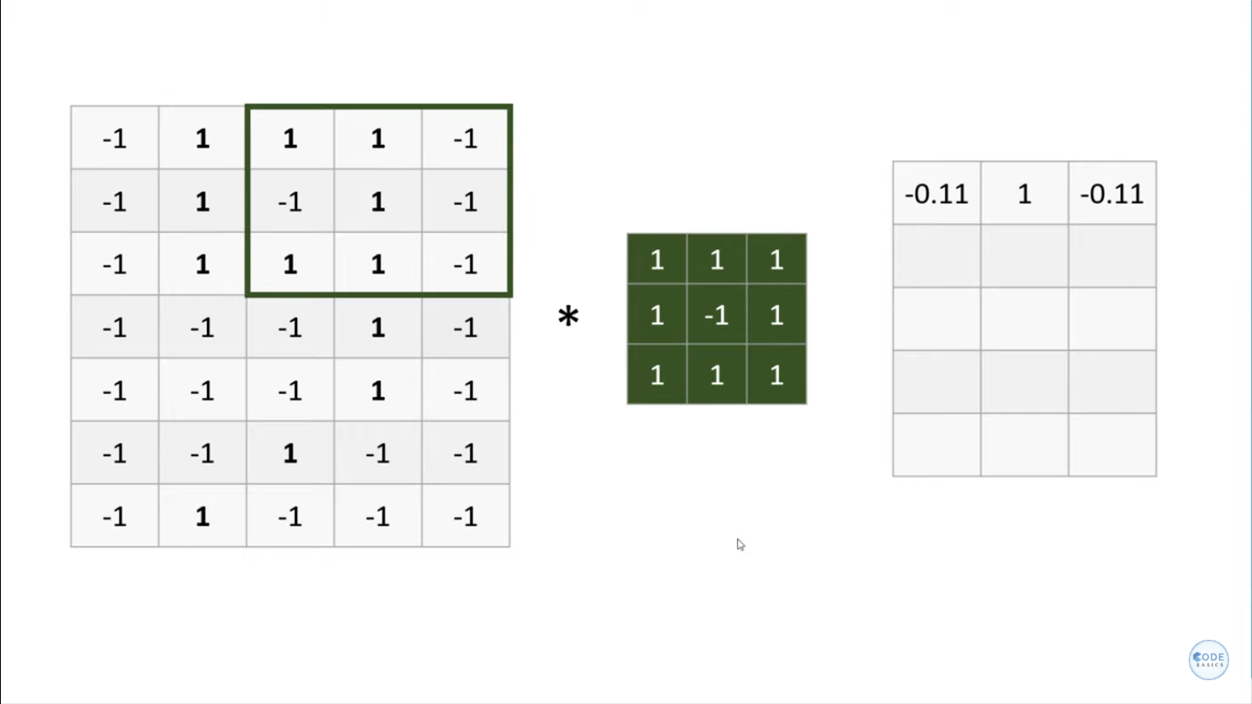

Slide 15
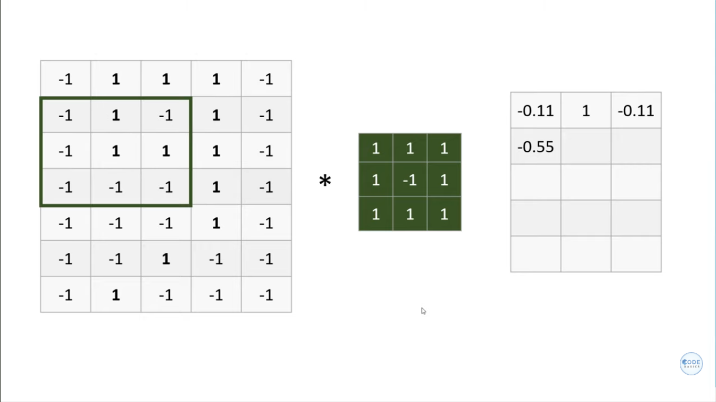
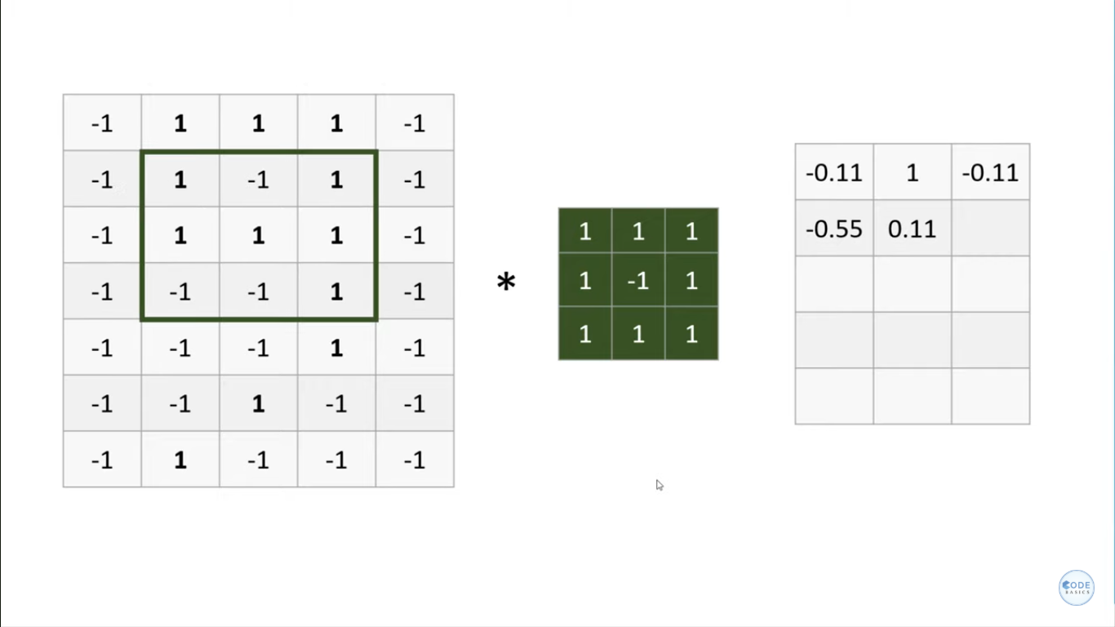

Slide 16
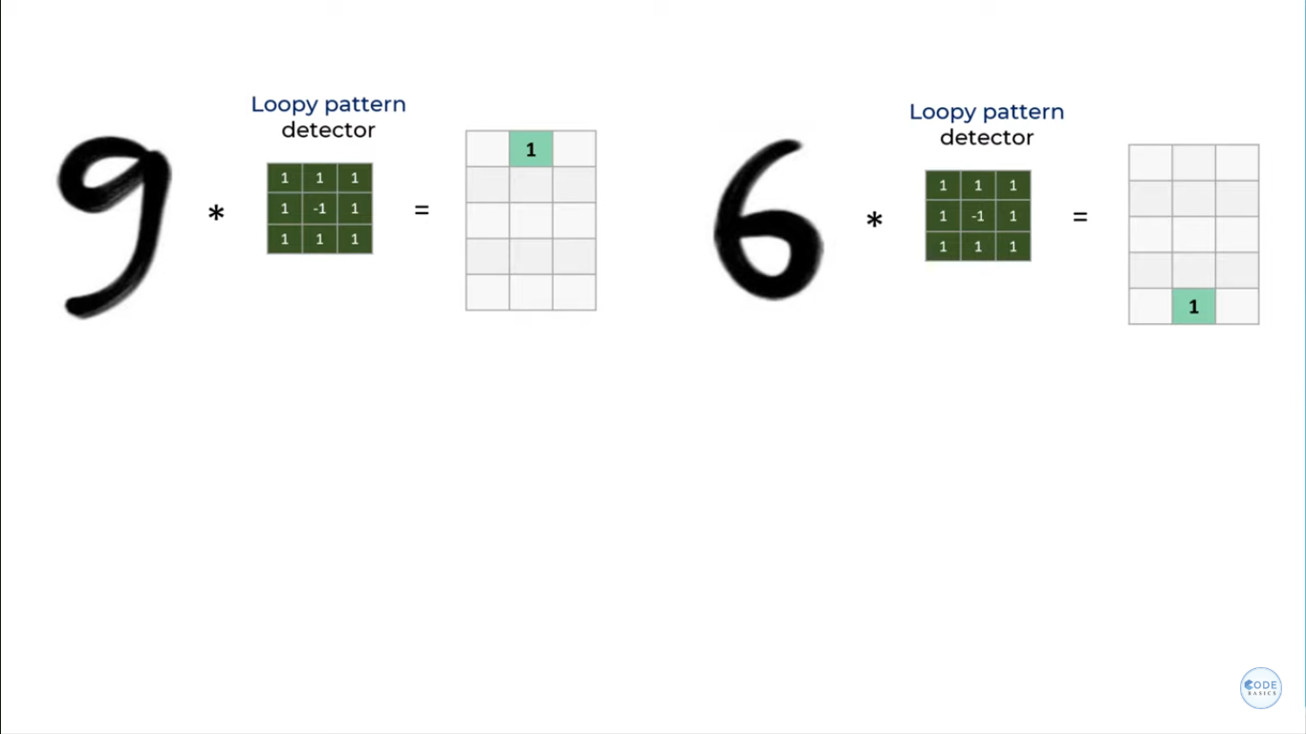
Feature map has value near to 1 where the concerned shape or pattern is found

Slide 17
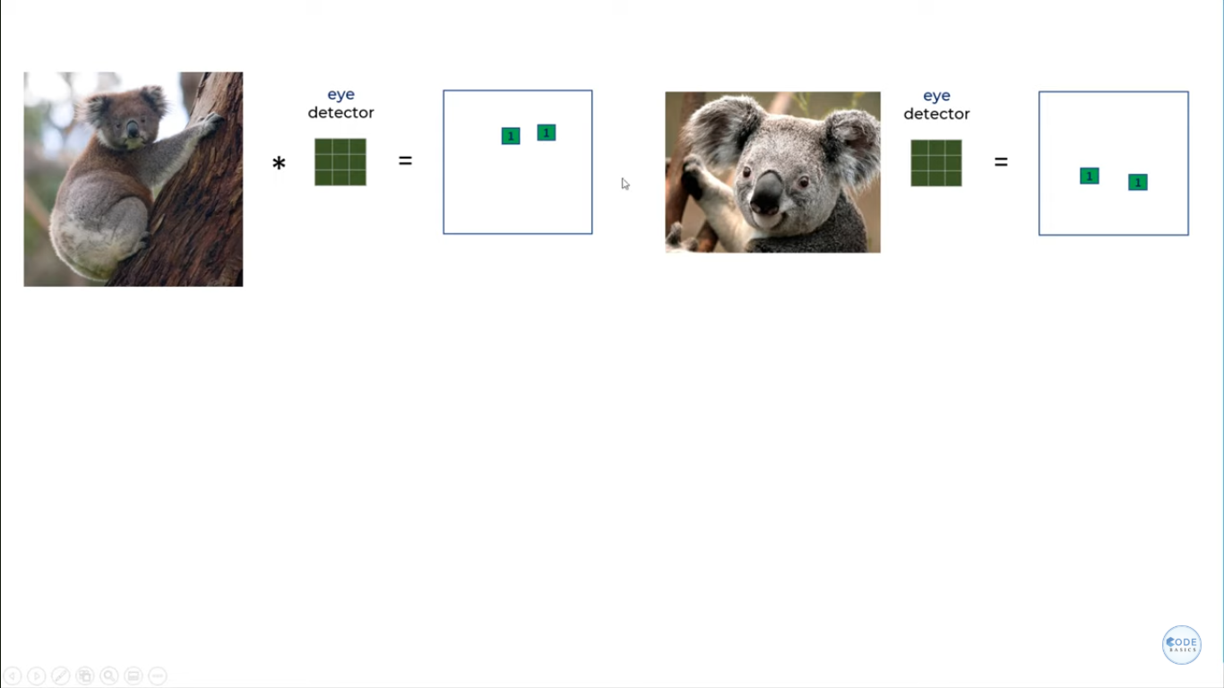
Convolutional filters are able to detect the patterns irrespective of their location in the image structure.

Slide 18
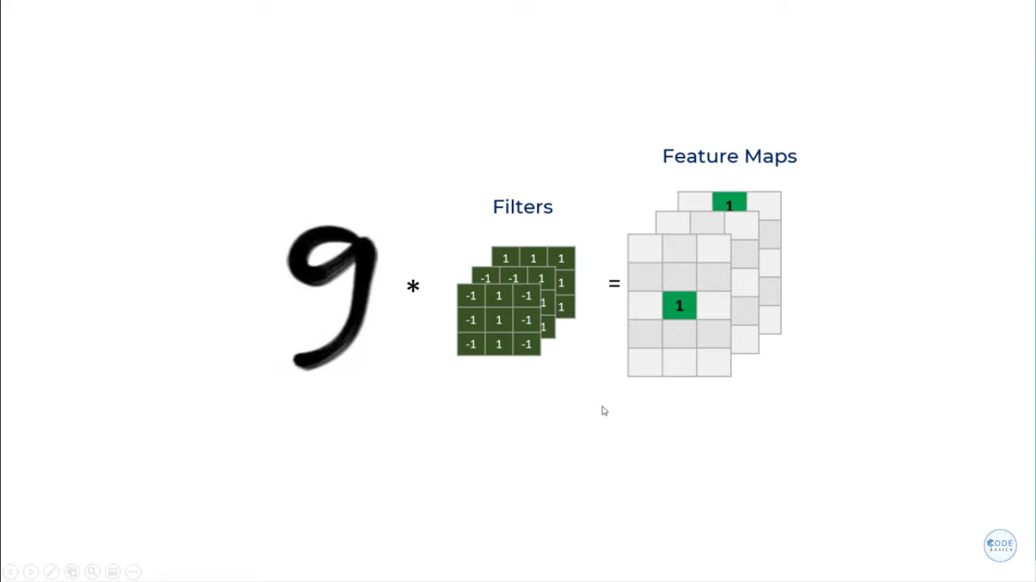
We get three feature maps because we are detecting 3 patterns in digit 9 and so we have 3 filters.

Slide 19
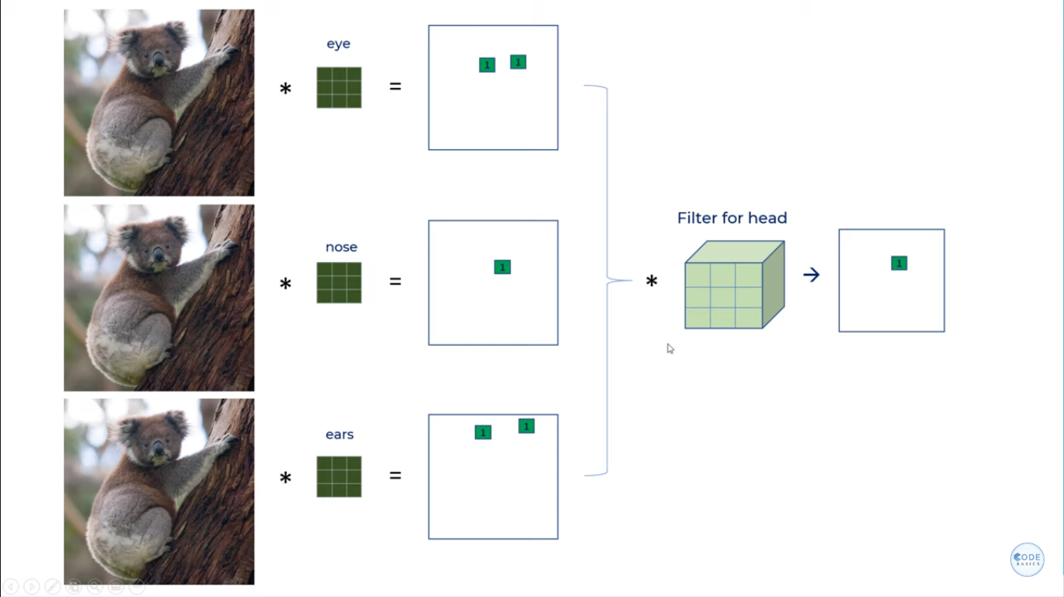

Slide 20
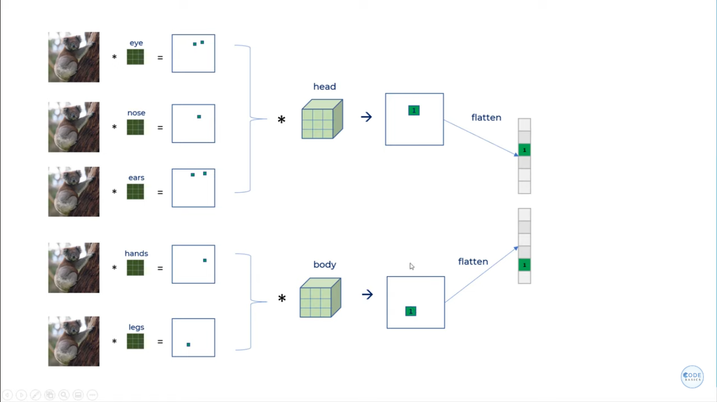

Slide 21
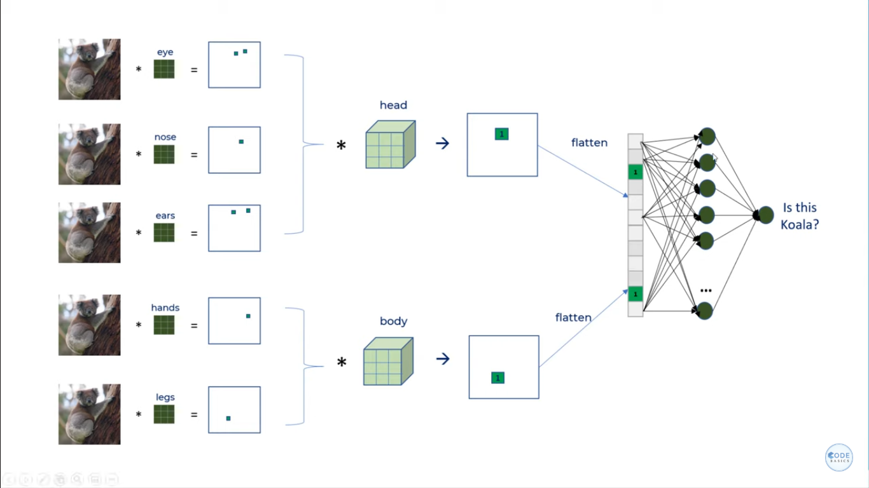

Slide 22
In the 1st part, using cnn operations, system will do feature extraction. What patterns are to be recognized?
In the 2nd part we apply ANN, which flattens the feature map we got as result and train neural network accordingly.
4
7. Dicussion,Conclusion and Refrences

Slide 23
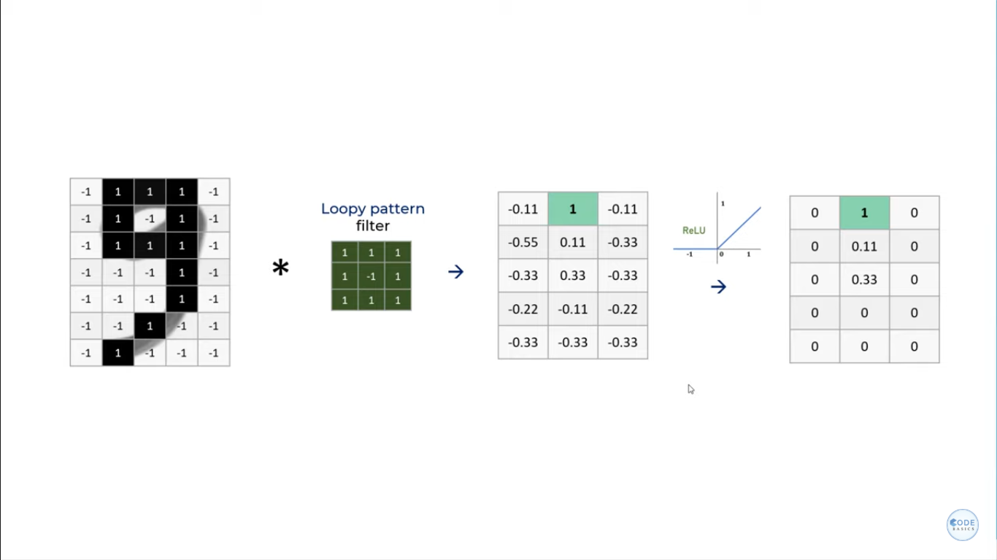

Slide 24
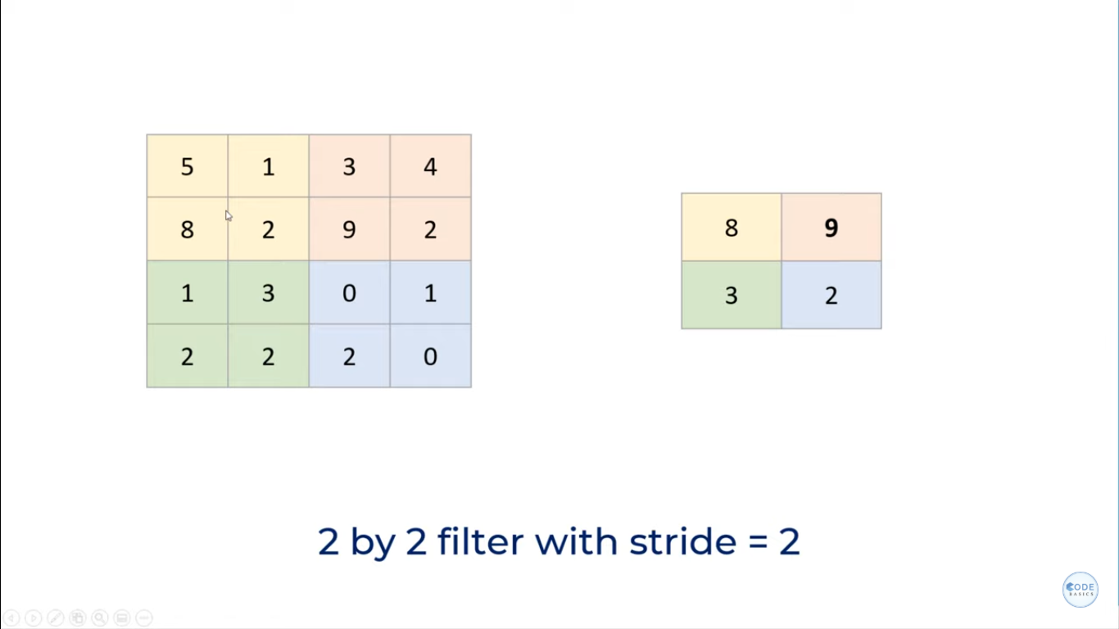
In max pooling, we reduce the size of feature map further to minimize computational power of computer used

Slide 25
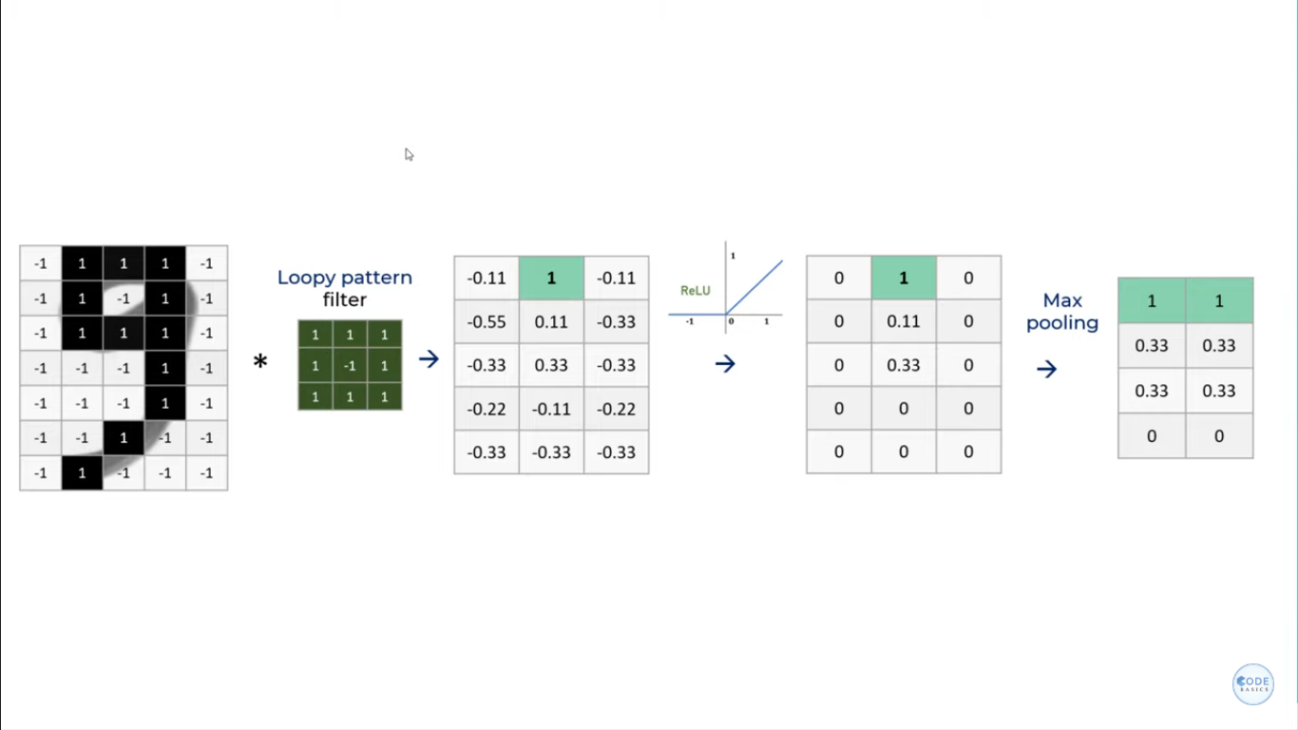

Slide 26
